Slide 1
“AGIOS spYridonas” SPECIAL SCHOOL
A public school under the law on special education attended by people with serious, multiple and complex disabilities

Slide 2
Population
119 students
31 girls
88 boys

Slide 3
students
Mental handicapped
Cerebral palsy
Developmental disorders
Genetic syndromes
Autism spectrum disorders
Psychiatric illnesses
Children with delinquent behaviour
Sensory impairments of vision and hearing
Epilepsy
Emotional difficulties
Mobility issues

Slide 4
Main purpose
Special education
Treatment
Care services

Slide 5
District committee of special educational needs
Diagnostic assessment by a multidisciplinary team
Suggestions to the committee about the type of school the child should attend (considering pupil’s needs)
Full attendance
Partial attendance
Reassessment every 2 years

Slide 6
Saint spyridonas
Primary level
Addressed to pupils aged 6 – 12 years
8 classes
According to their needs and
Secondary level
Addressed to pupils aged 12 – 18/21 years
8 classes
capabilities

Slide 7
Principles and values of the school
Education for all in an organized, safe, warm and stimulating environment
Individually learning experiences and programs
High and realistic expectation
Opportunities for creativity

Slide 8
VISION
Acceptance and respect for the uniqueness of each student
Through cooperative work, acceptance, respect, participation, mutual understanding among staff, parents and students
Achieve the maximum
As part of the community

Slide 9
We want every pupil to feel
I am healthy
I am safe
I am alive and happy
I am learning and achieving
I am positively and actively involved
I am welcomed to the team
I am part of the community

Slide 10
STAFF
1 Director
3 Assistant Directors

Slide 11
Educational staff
16 Special Teachers (16 classrooms)
6 Special physical education teachers
3 Technical education teachers
1 costume designer teacher
1 teacher of the blind

Slide 12
therapists
7 Physiotherapists
7 Speech therapists
8 Occupational therapists
5 Music therapists
1 Psychologist (once a week)

Slide 13
Support and coordination services
1 Secretary
1 Nurse
30 Teacher assistants
3 cleaning staff
3 Bus drivers

Slide 14
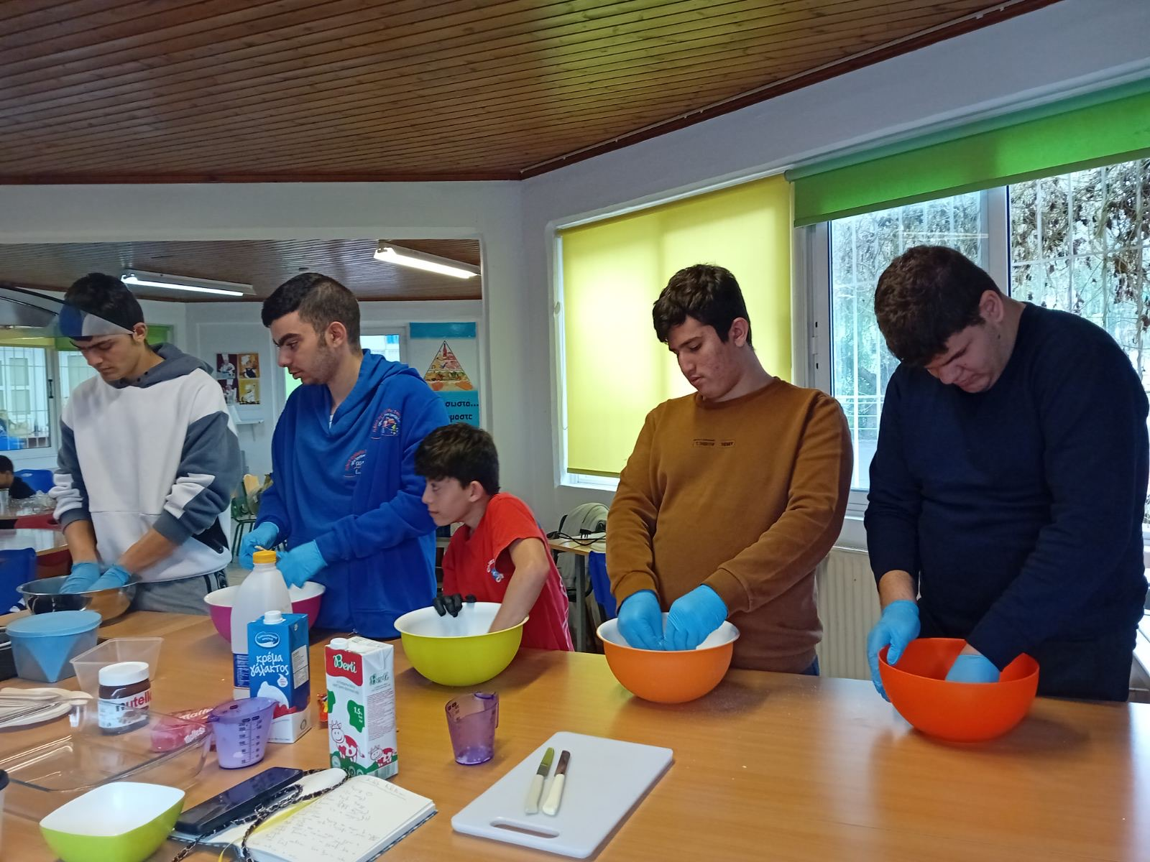
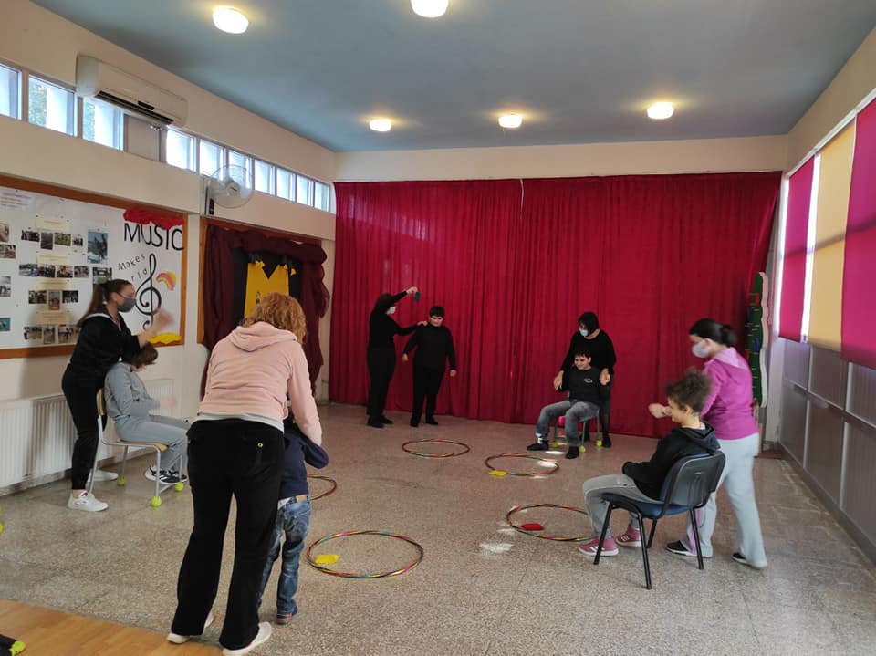
Expansion of the program with activities in the school
Household economy
Motor Activity Training Program (MATP)

Slide 15
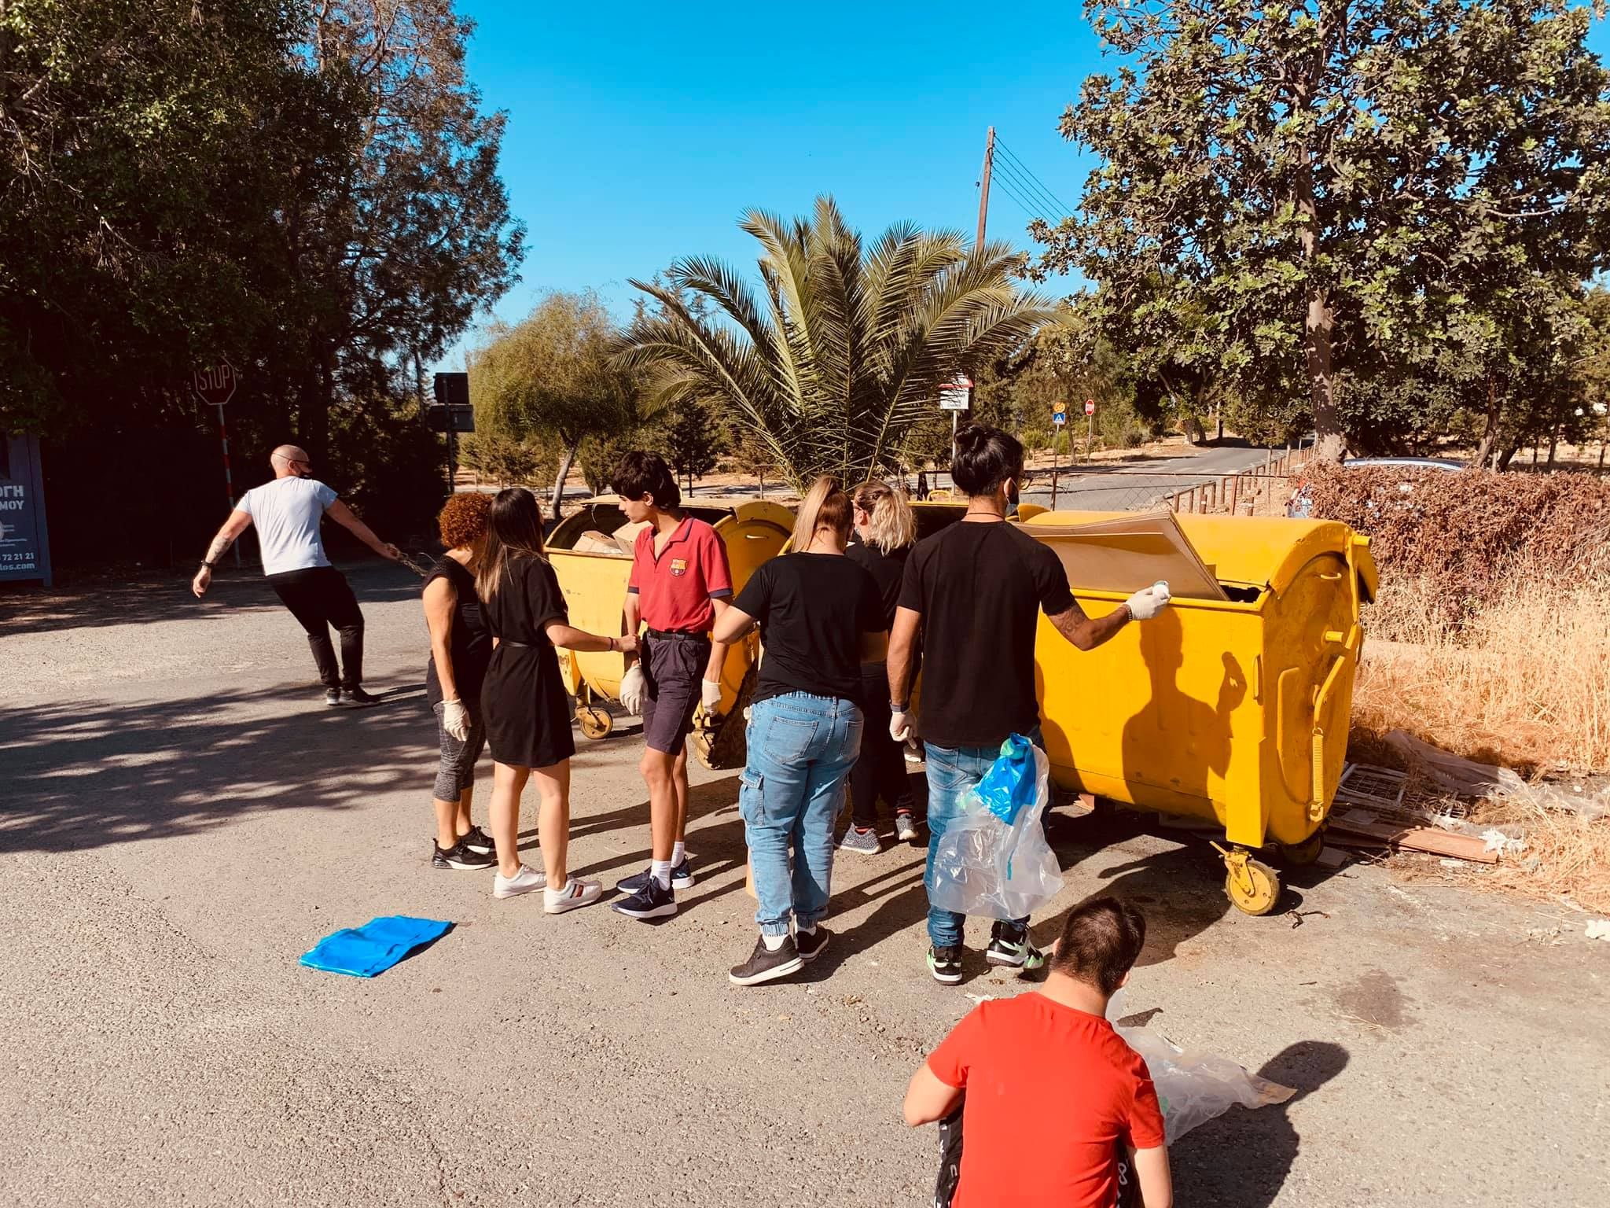
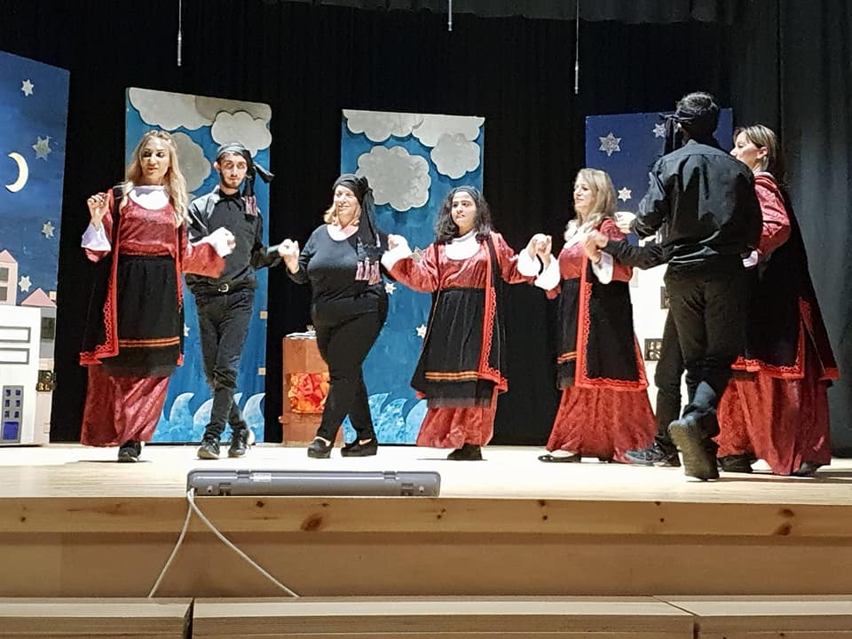
Recycling
Dancing

Slide 16
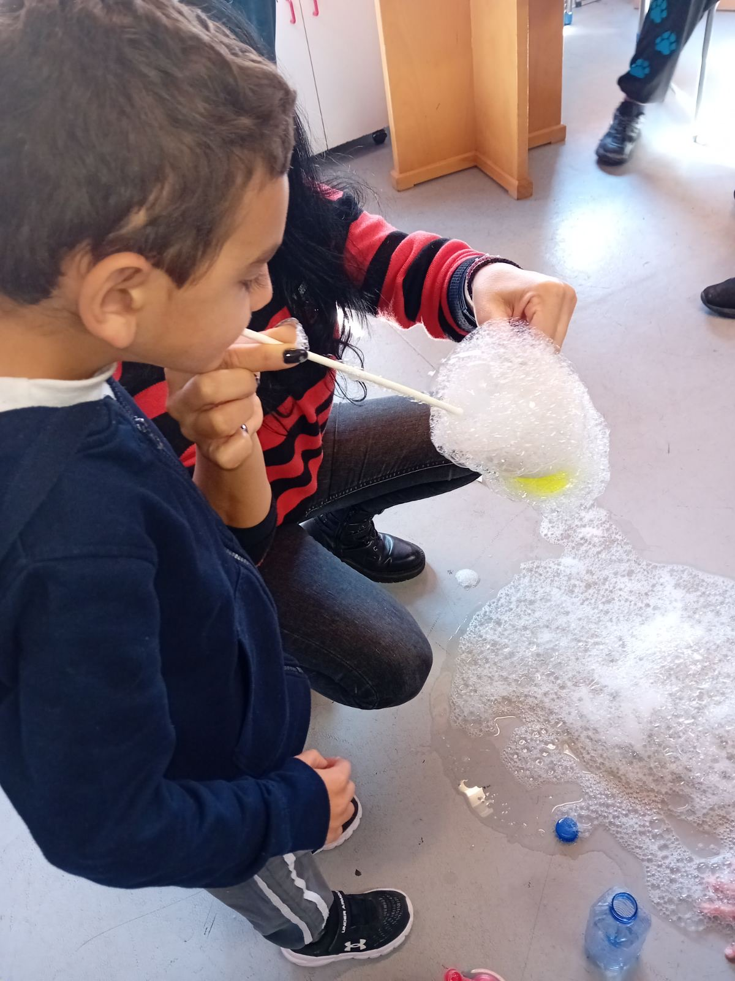
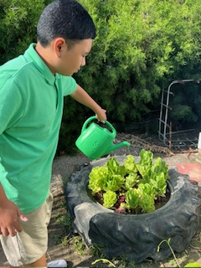
Attention Autism
Gardening / Greenhouse

Slide 17
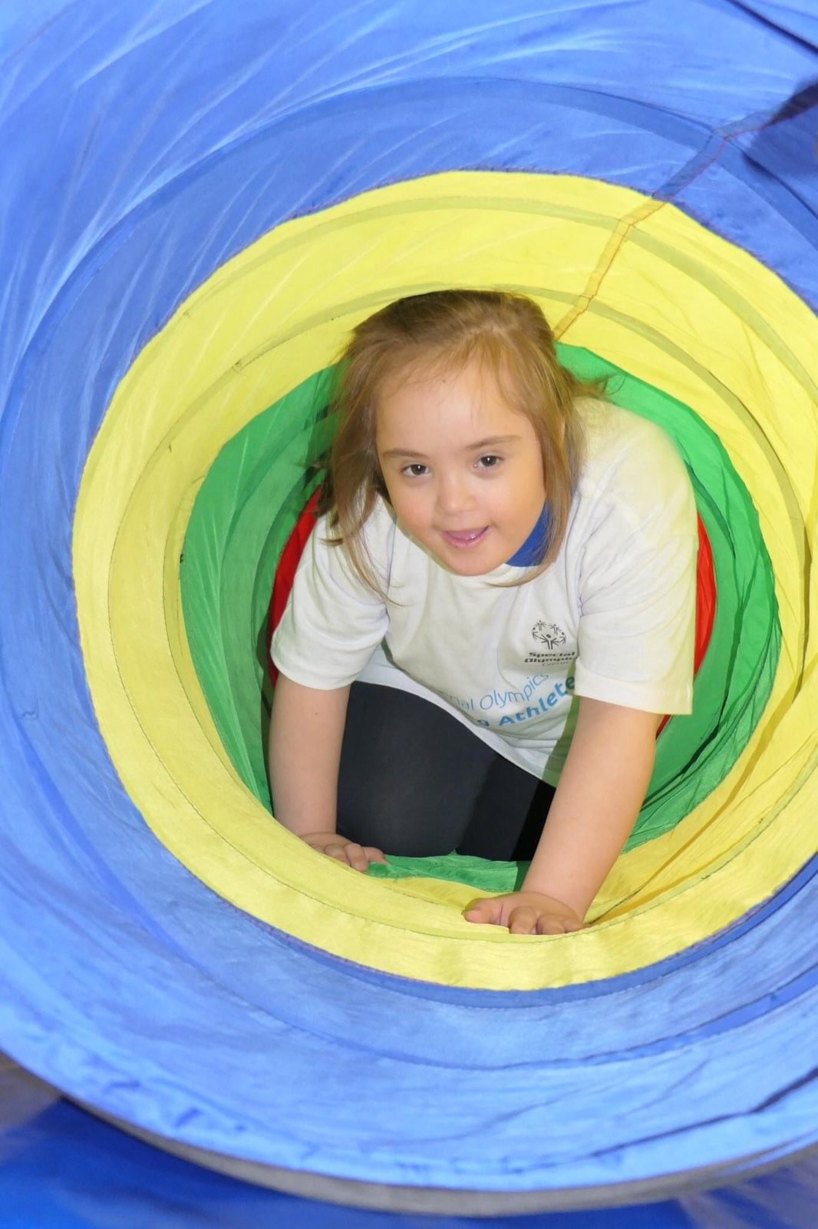
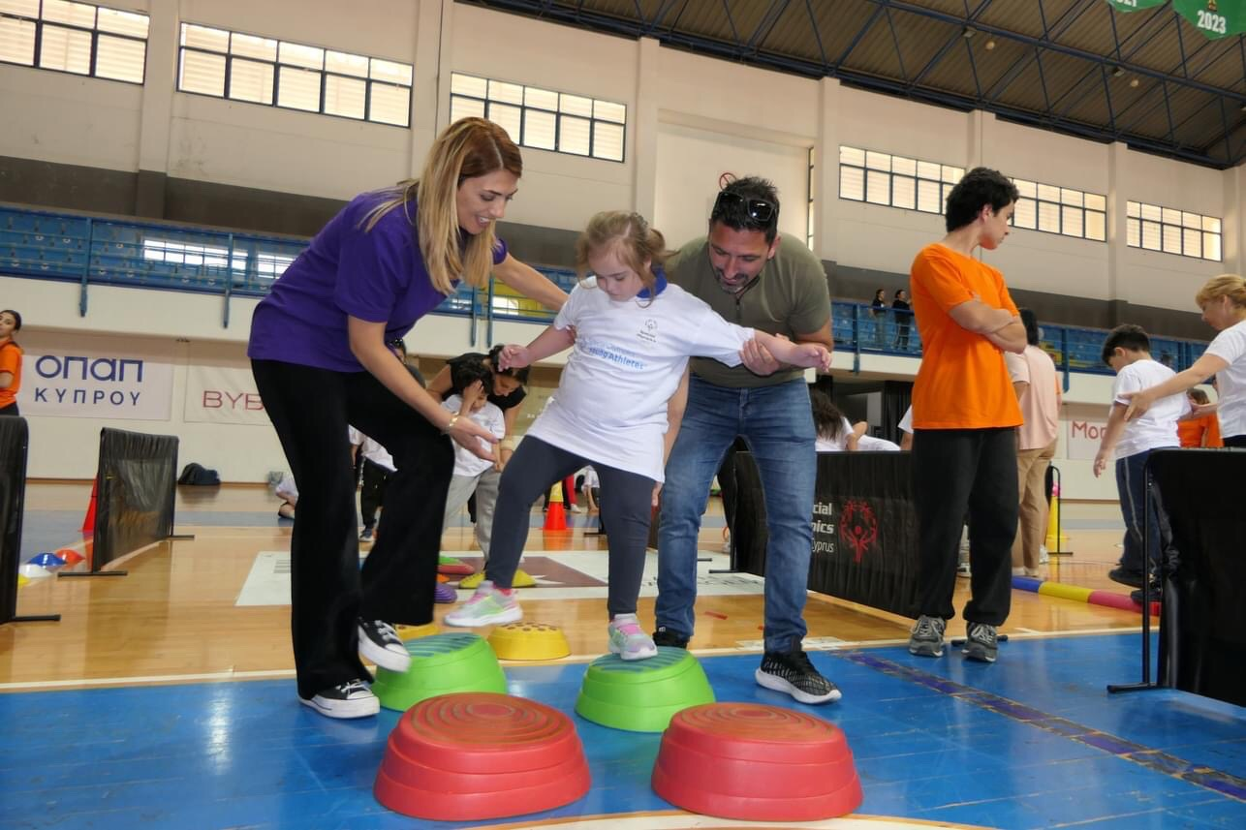
Young Athletes

Slide 18
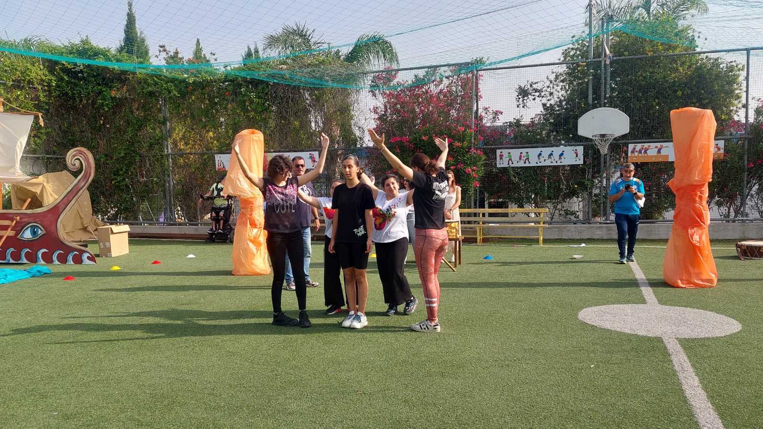
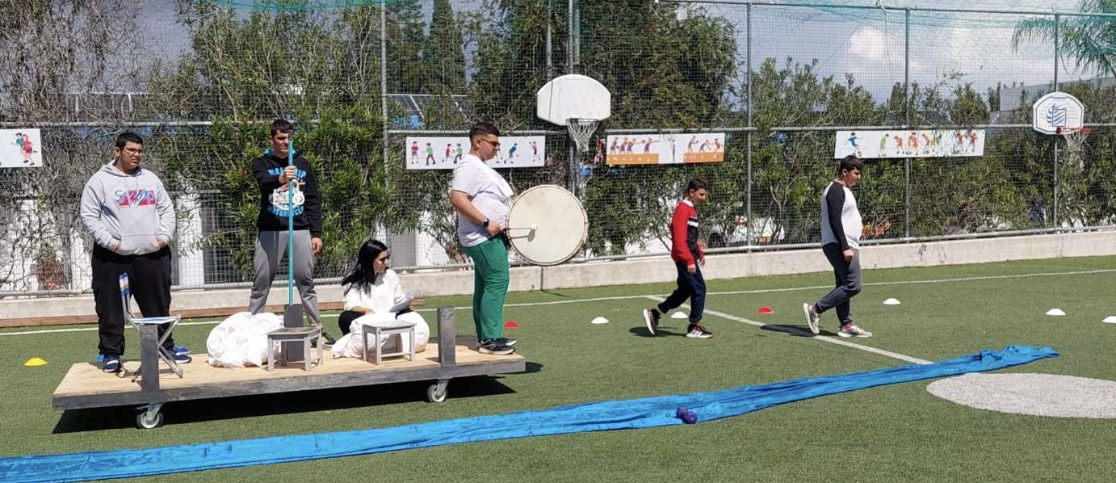
Theatrical education

Slide 19
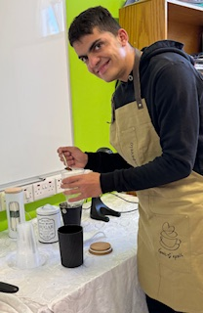
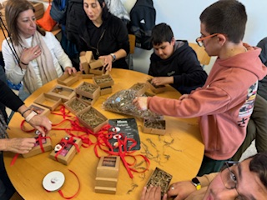
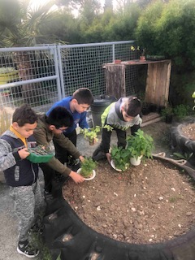
Botanic garden
Prevocational training

Slide 20
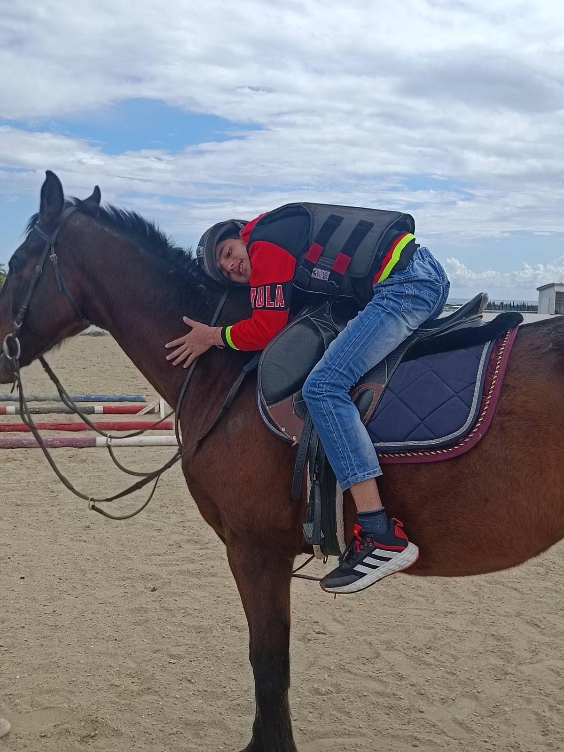
Expansion of the program with activities outside of the school
Therapeutic horse back riding

Slide 21
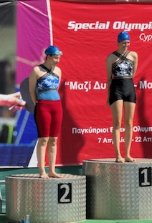
Athletic truck and field athletic (special Olympics)

Slide 22
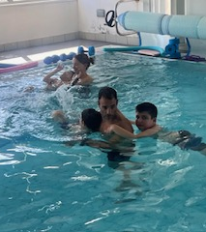
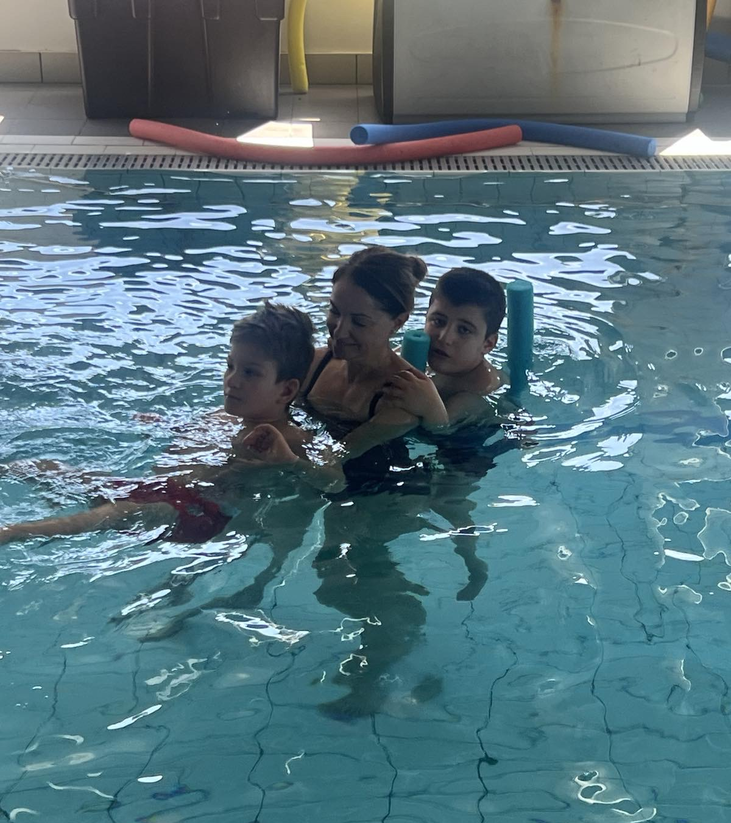
hydrotherapy

Slide 23
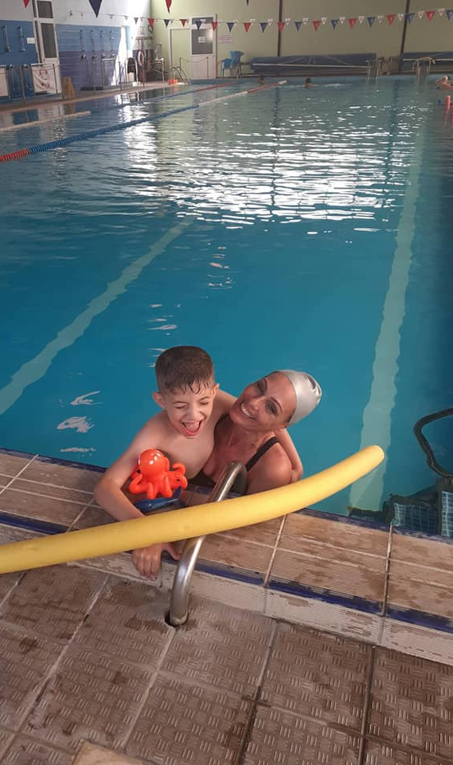
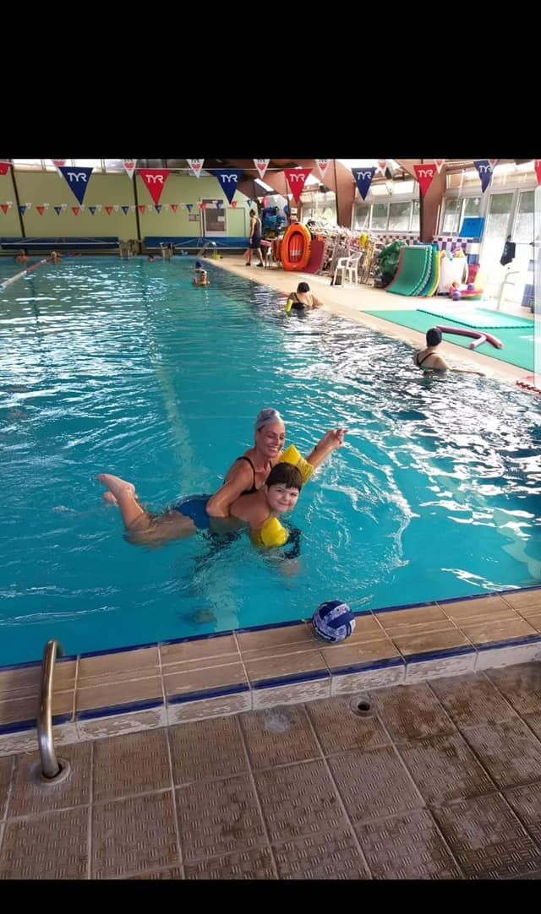
Swimming

Slide 24
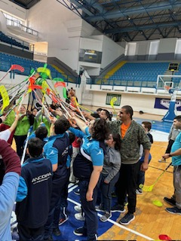
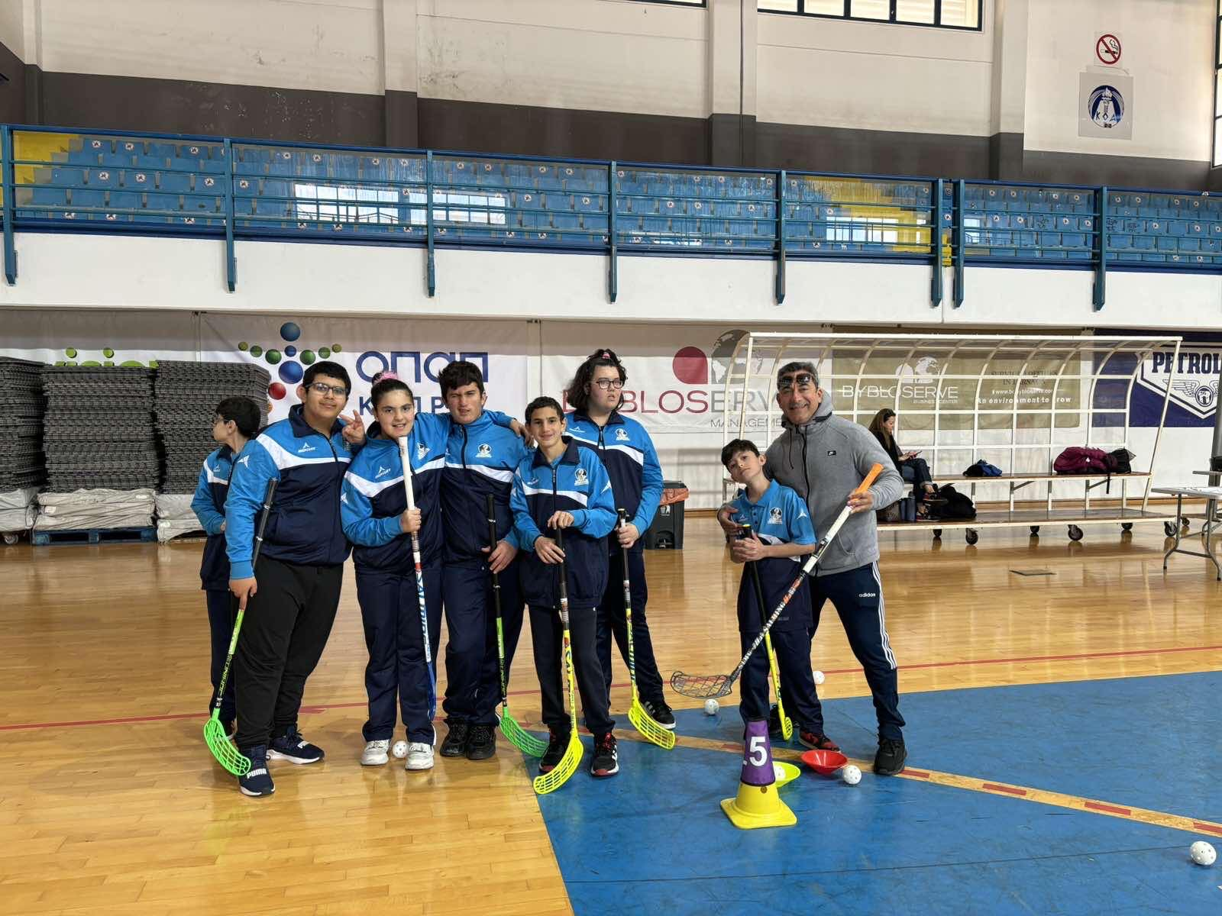
Floorball

Slide 25
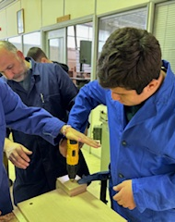
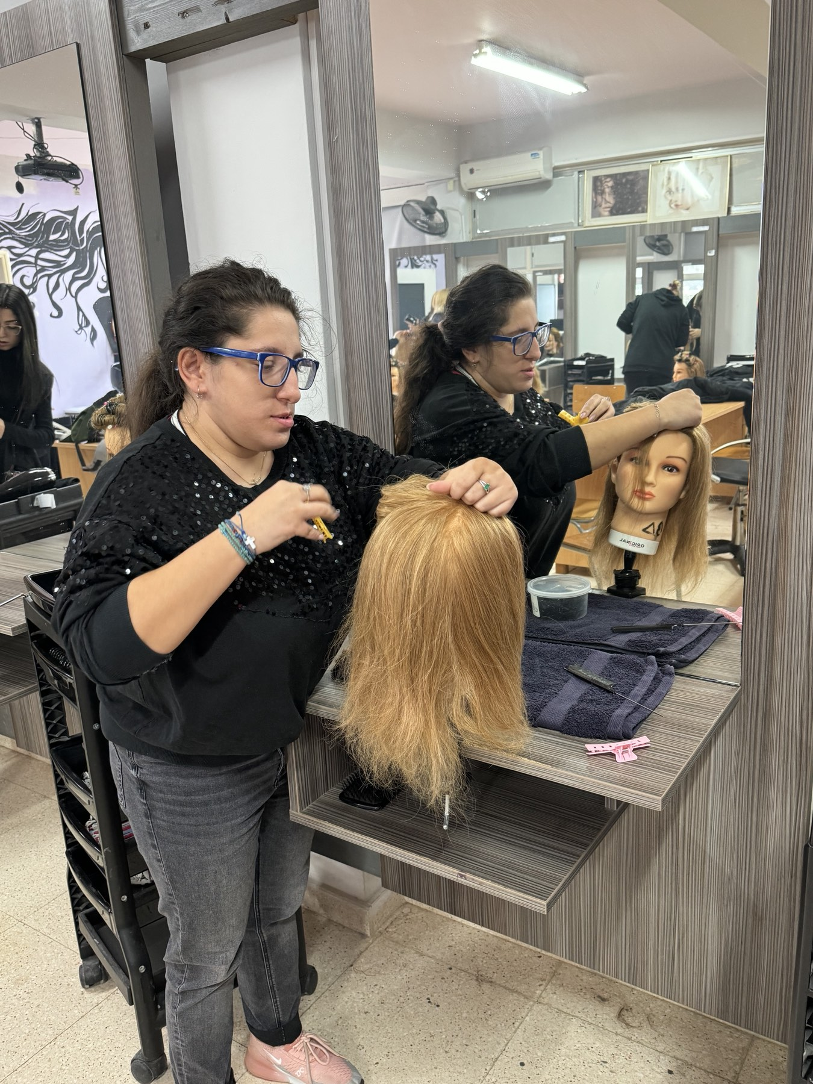
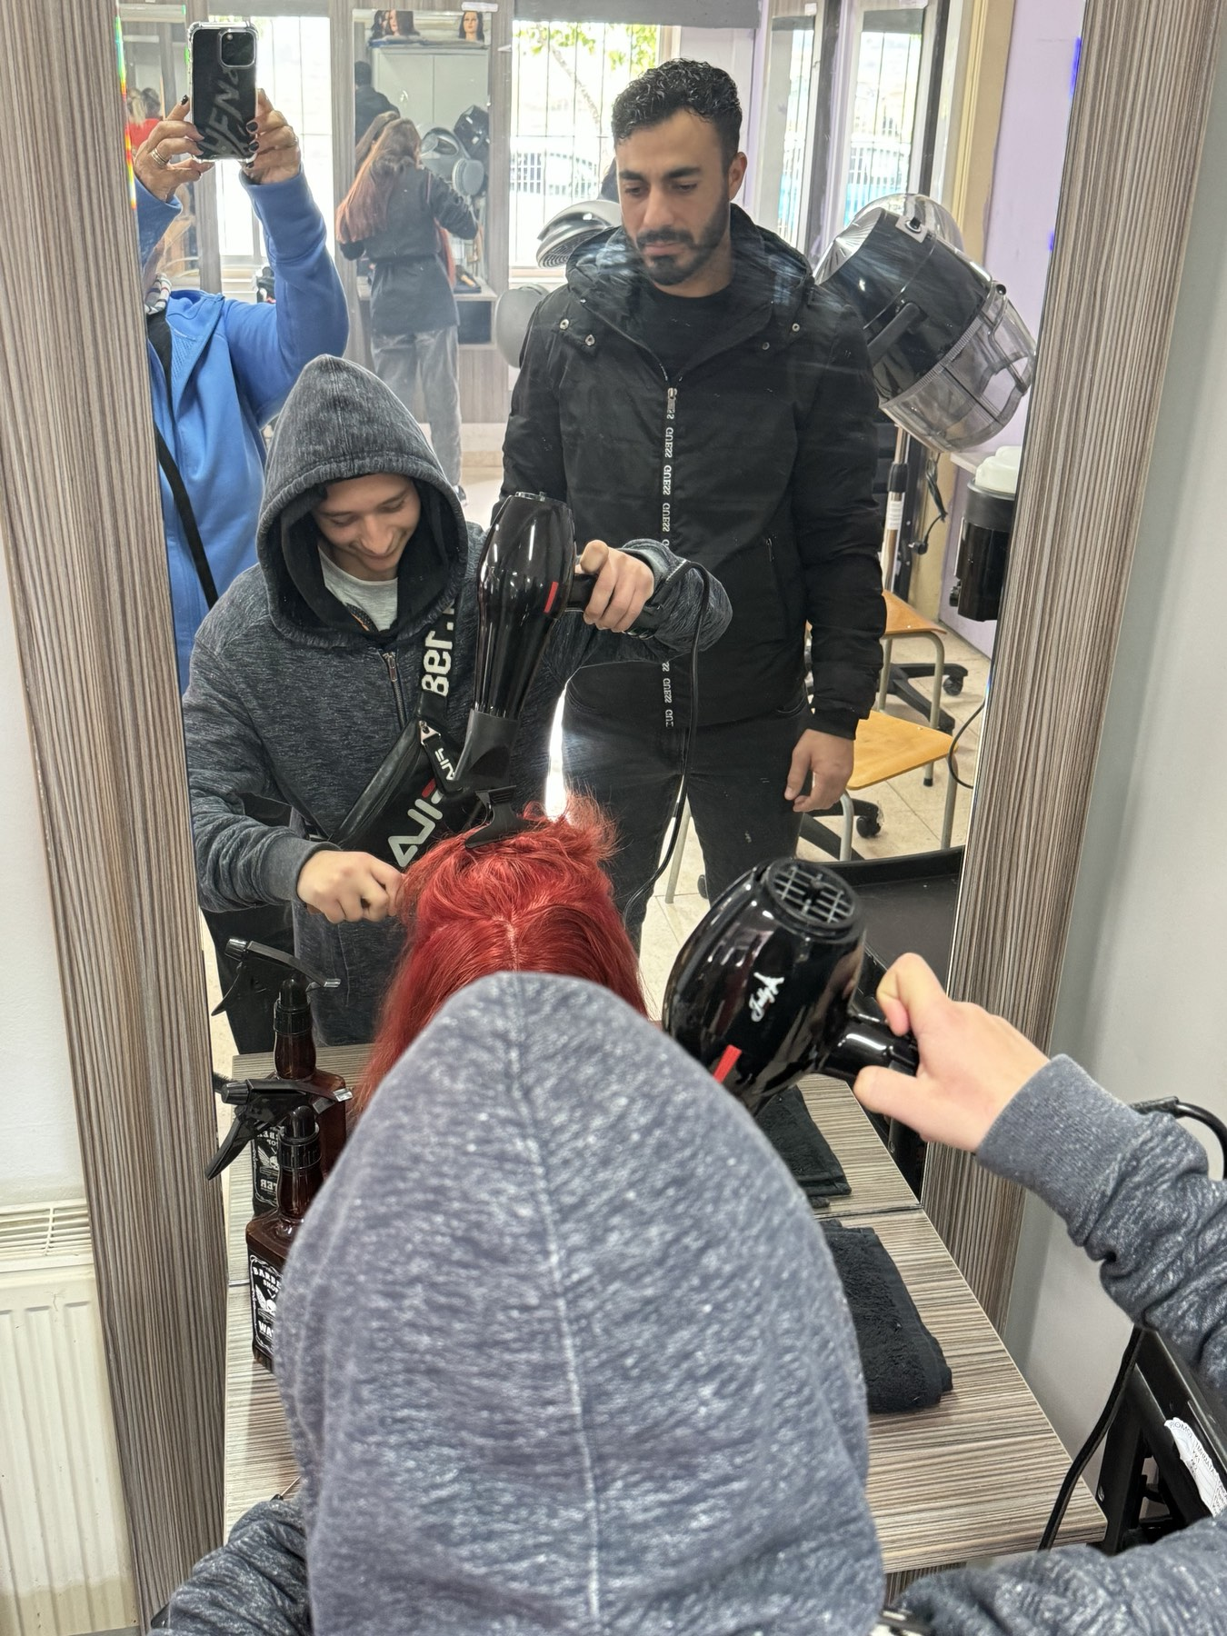
Partial attendance in technical schools

Slide 26
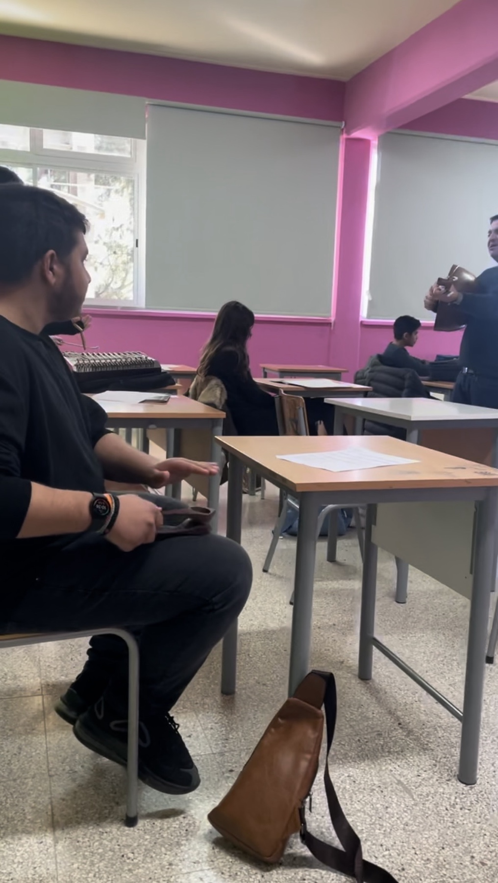
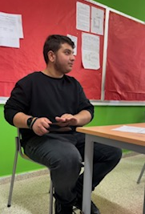
Partial attendance in music school

Slide 27
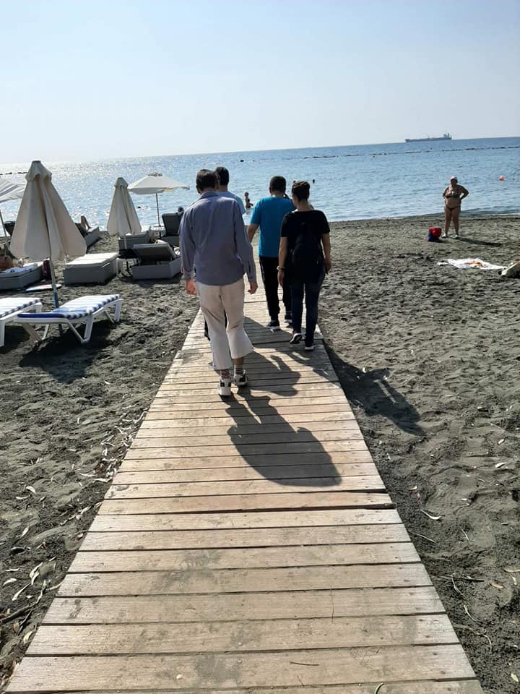
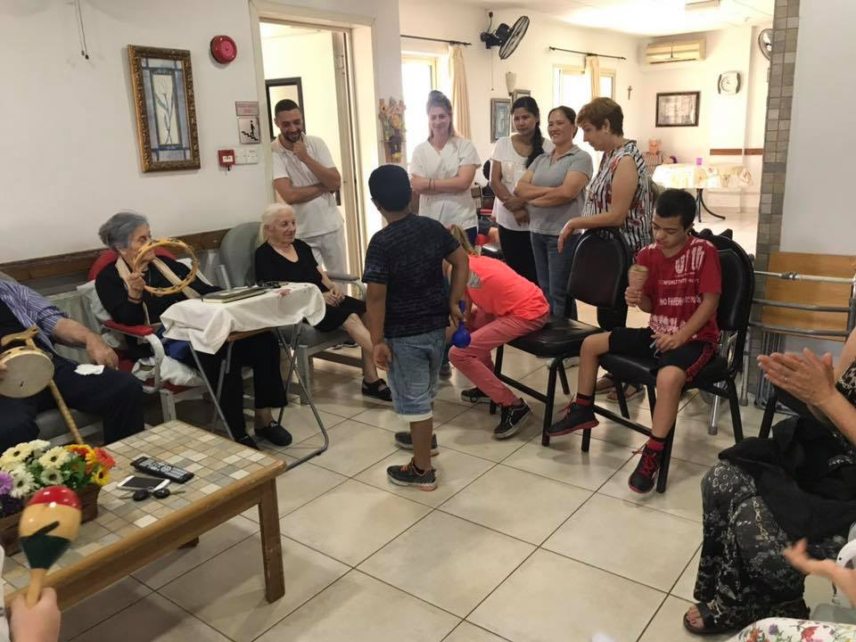
My town

Slide 28
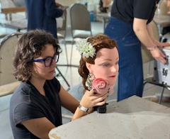
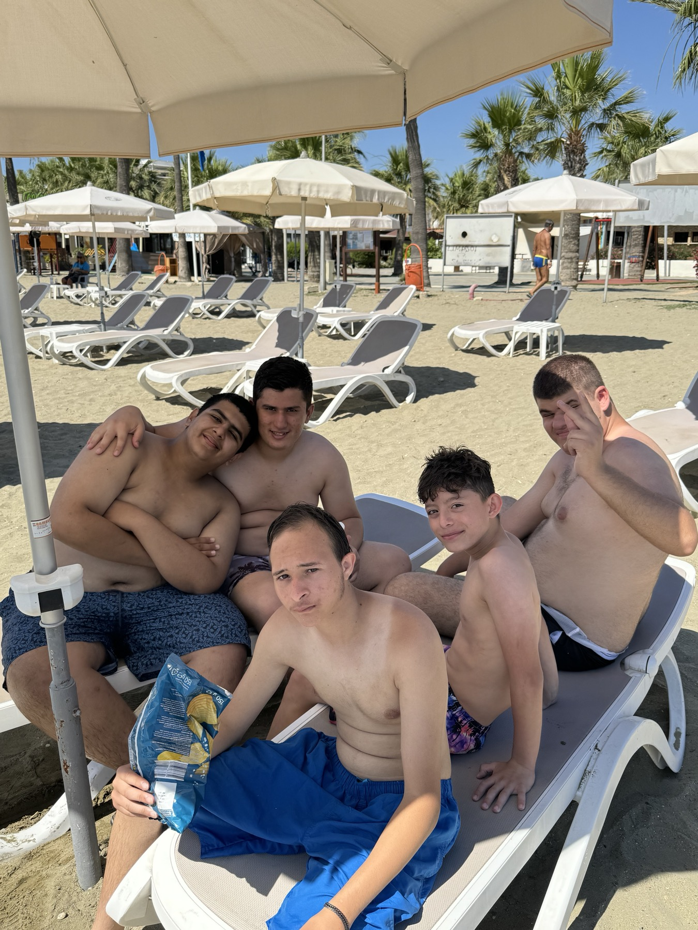
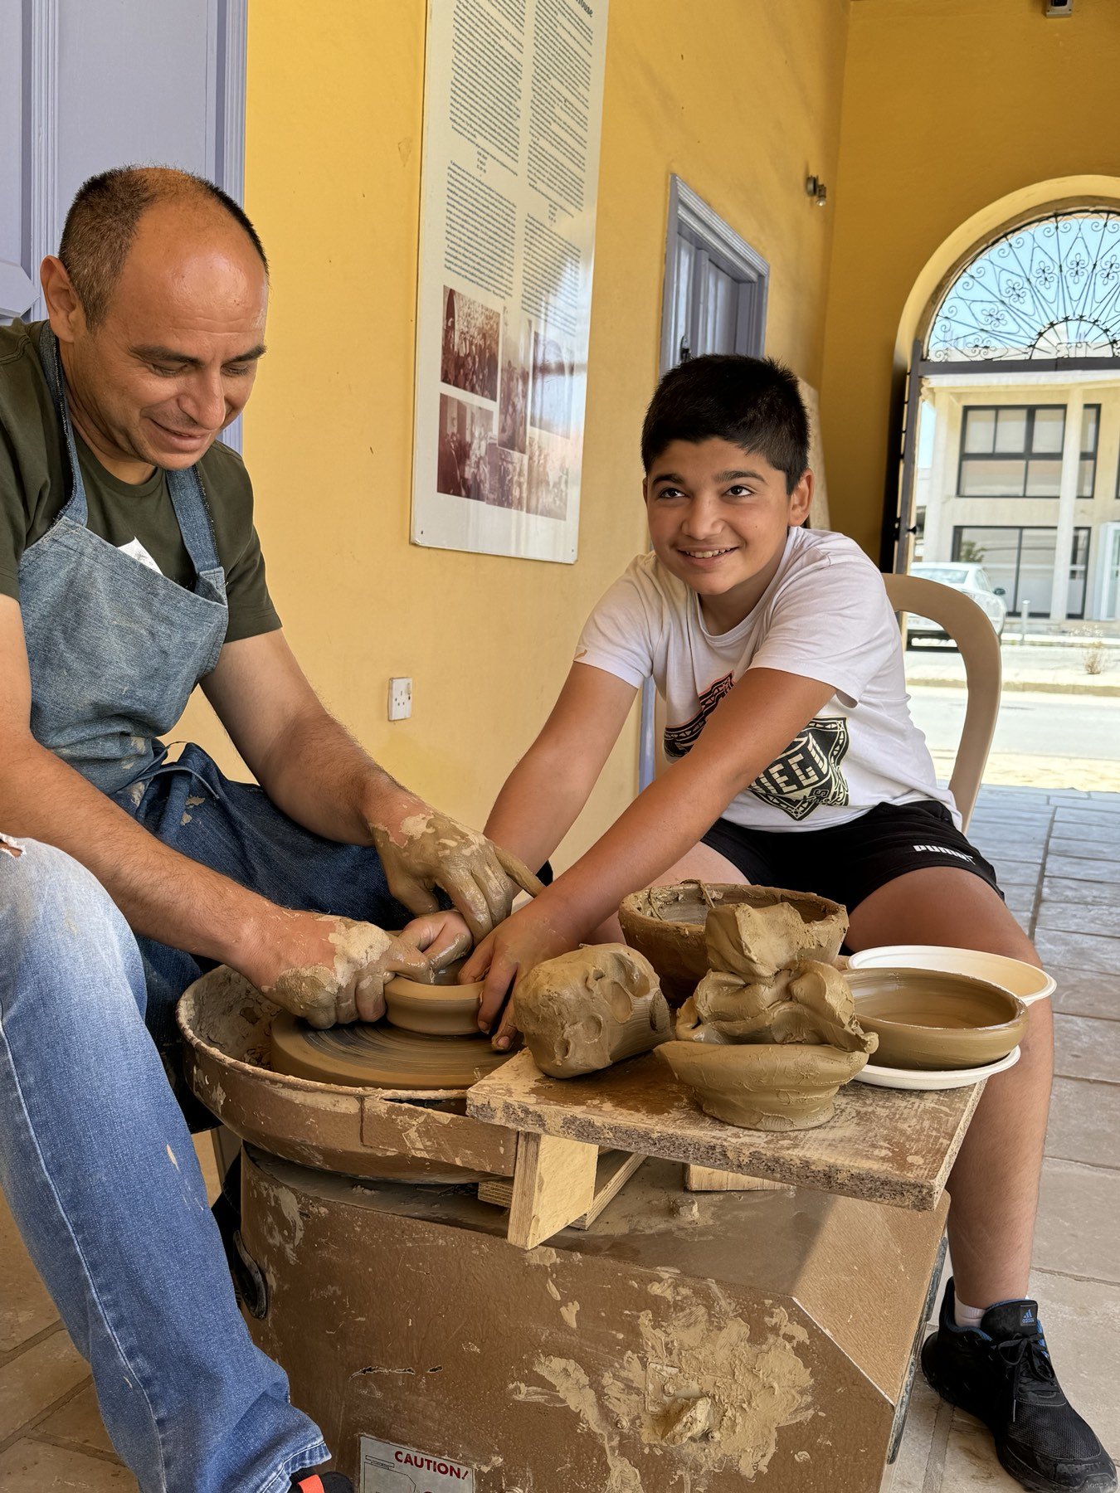
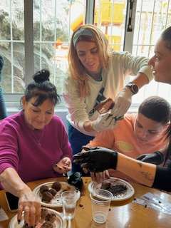
Social and recreational activities (visits, excursions, recreational events inside and outside school

Slide 29
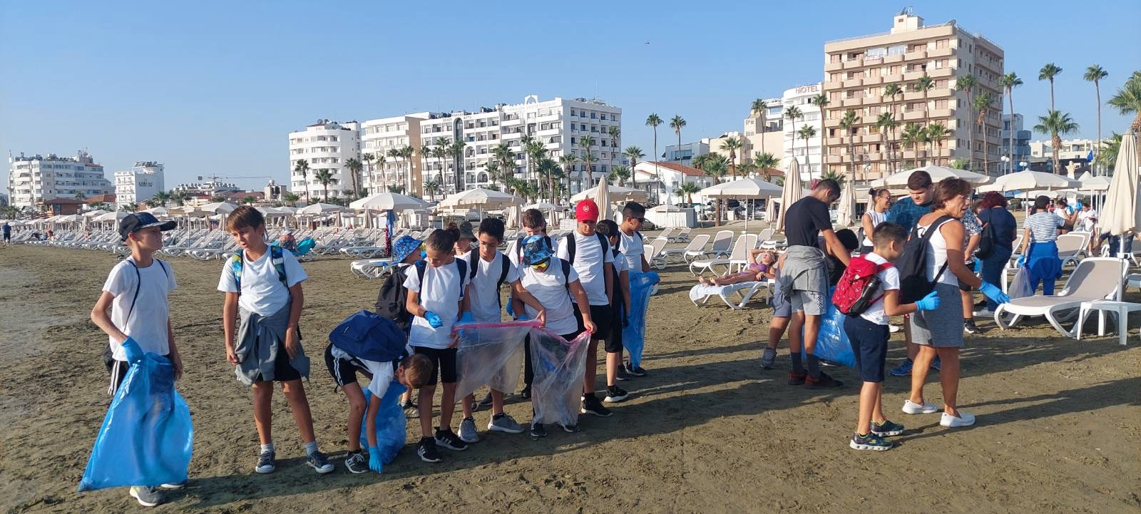
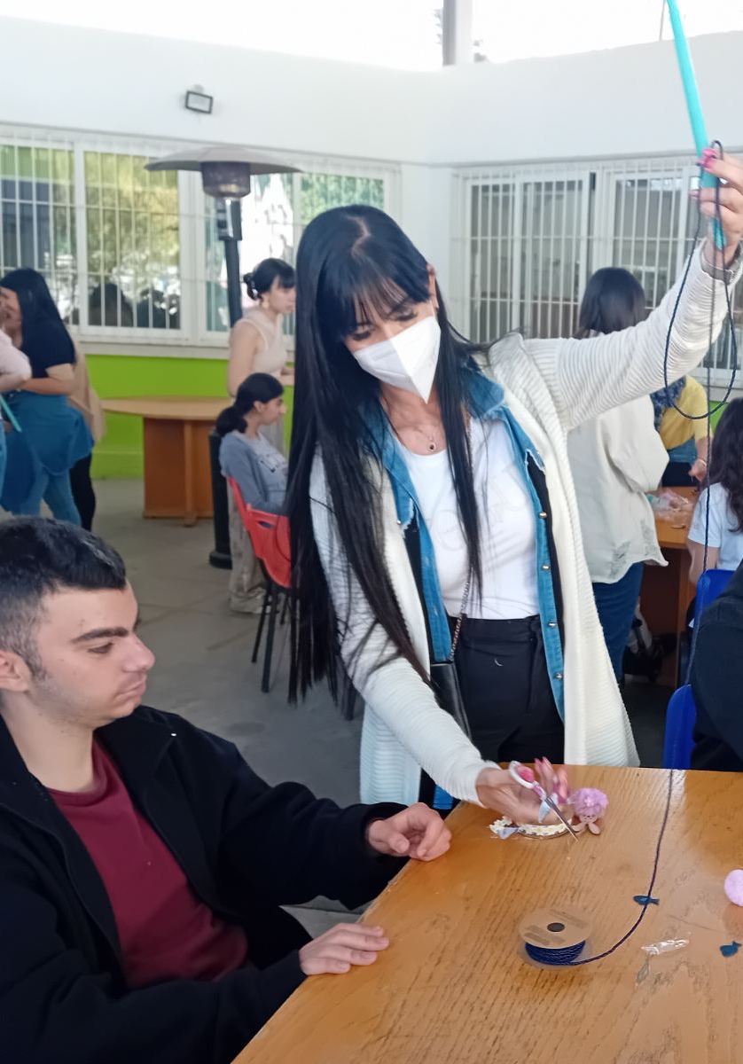
Cooperation with elementary and high schools

Slide 30
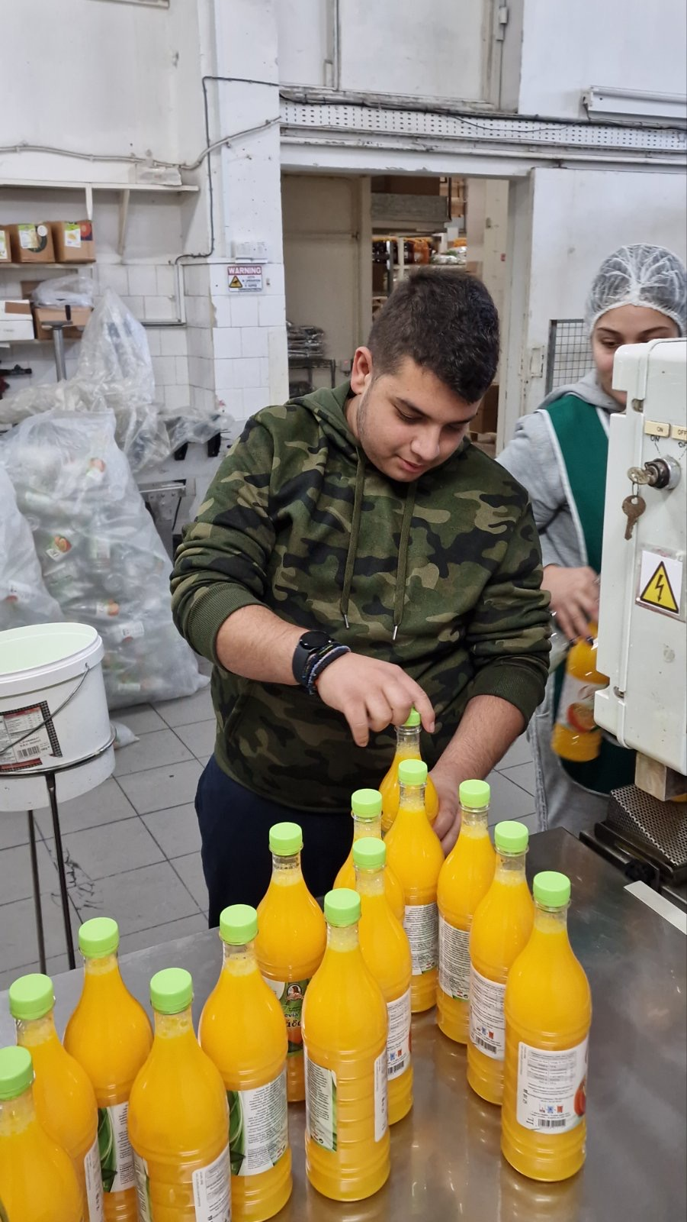
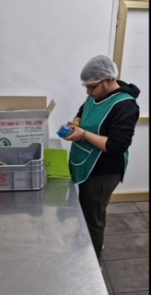
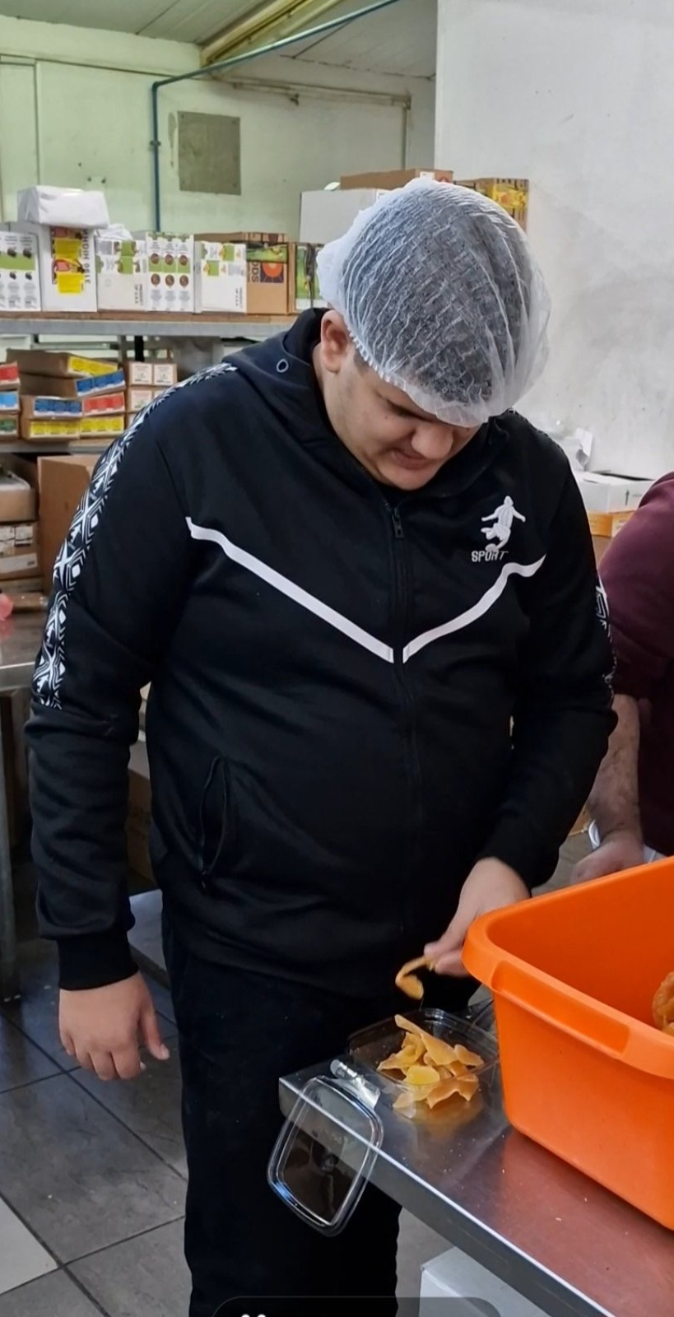
Employment/work experiences

